Slide 1

Introduction to Linux
Garance Sarton-Lohéac
SAGE
27.09.2022
Adapted from a presentation by N. Glover, G. Bonilla-Rosso, G. Baud
1
Notes:
1

Slide 2
Learning Objectives
By the end of this lecture…
1. … you should understand...
… the advantages of using a Linux-based system on a computing cluster
… the file structure of a UNIX system
2. … you should be able to...
… connect from your computer to the cluster,
… manipulate files inside and into the file system,
… perform basic operations on sequence files,
… write and run scripts from bash.
2
Notes:
2

Slide 3

Notes:
Who is familiar with UNIX / LINUX ?
What is the average length of a bacterial genome ? Any idea how many pages this would represent ?

Slide 4

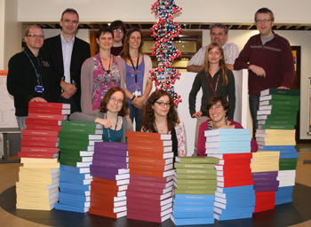
Reading Genomes...
The average length of bacterial genomes is 2.5 Mbp.
If printed, it would take 7 books per genome (2622 letters per page, no spaces, double-sided, 670 pages per book)
Order matters...
1 bacterial genome
Human genome
4
Notes:
4
If you have this on your computer how would you read it ?

Slide 5
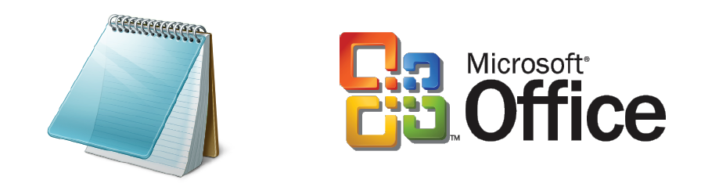
How to open such files?
Notepad?
Office?
Both not well suited for big files…
5
Notes:
5

Slide 6
What is Linux ?
A family of open source stable, multi-user, multi-tasking operating system (OS) for servers, desktops and laptops.
Based on the kernel developed in 1991 by Linus Torvalds... in turn based on UNIX (first developed in the 1960s by AT&T)
Popular Linux distributions:
Debian-Ubuntu
RedHat/Fedora/CentOS
OpenSUSE
AndroidOS
macOS (UNIX)
6
Notes:
6

Slide 7
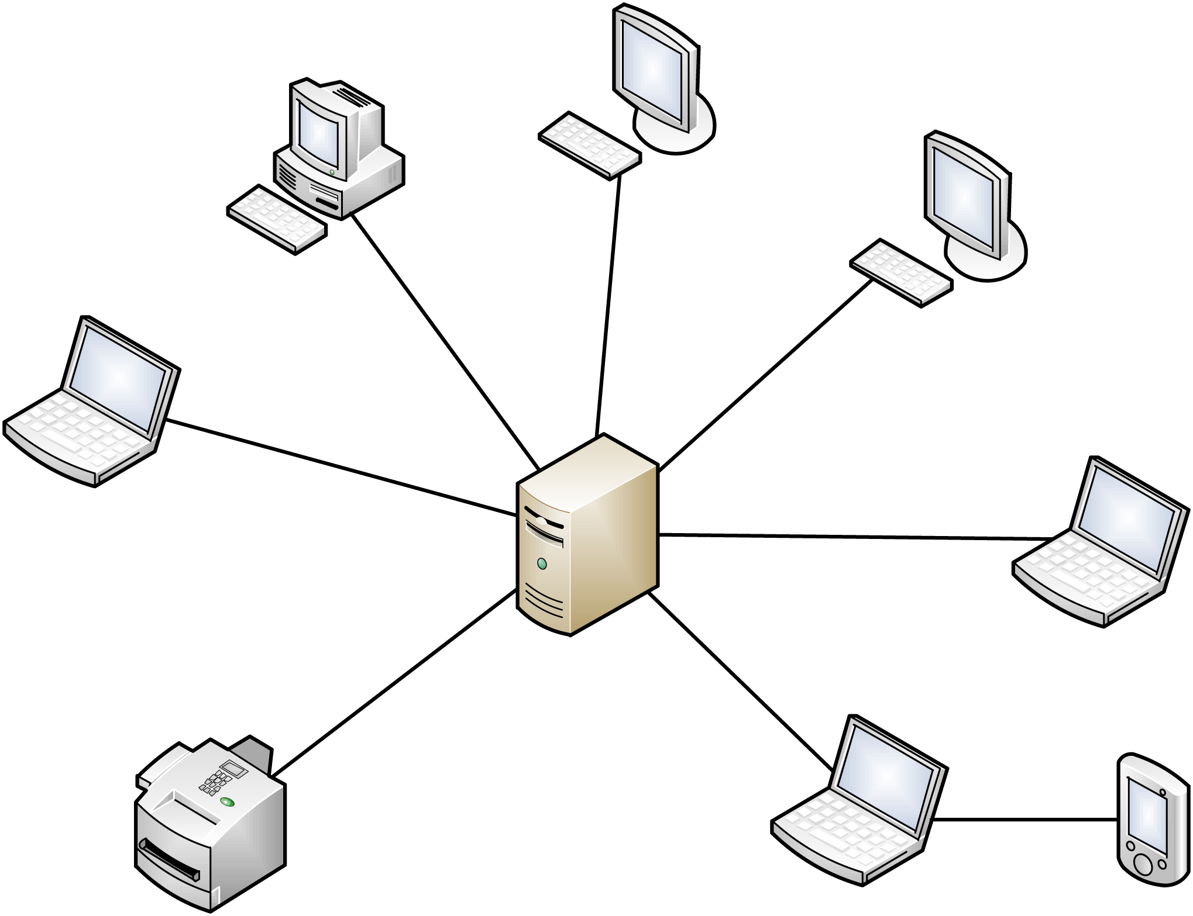
A multi-task, multi-user system
user1: cat
user6:ssh
user2: who
user5:print
linux
computer
user3:mail
user4:internet
7
Notes:
multiuser operating system enables two or more users to run programs simultaneously.
multiprocessing operating system supports two or more processors running programs at the same time also known as Multitasking.

Slide 8
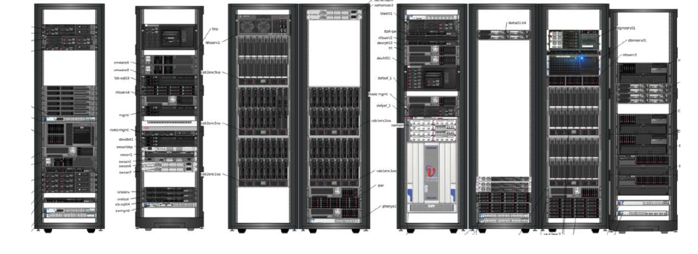
Cluster computing
High Performance Computing (HPC)
A cluster is a series of computers, linked together so that they can work together as a single system.
8
Notes:
8

Slide 9
Welcome to the wonderful world of the command lines
Notes:
It’s ok to struggle,
Practice will make it perfect (or at least easier)

Slide 10




The cluster and You...
Storage Server
/scratch or /archive
user1: mail
user2: clustalw
HPC
Curnagl
Server Front-End
user3: blastn
user4: scp
10
Notes:
How will you interact with the cluster ?

Slide 11
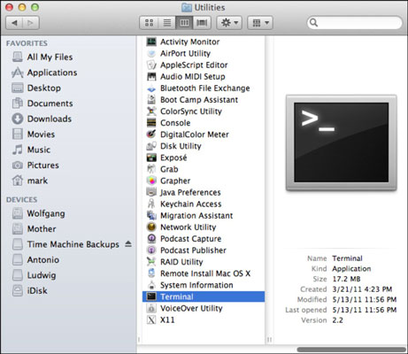
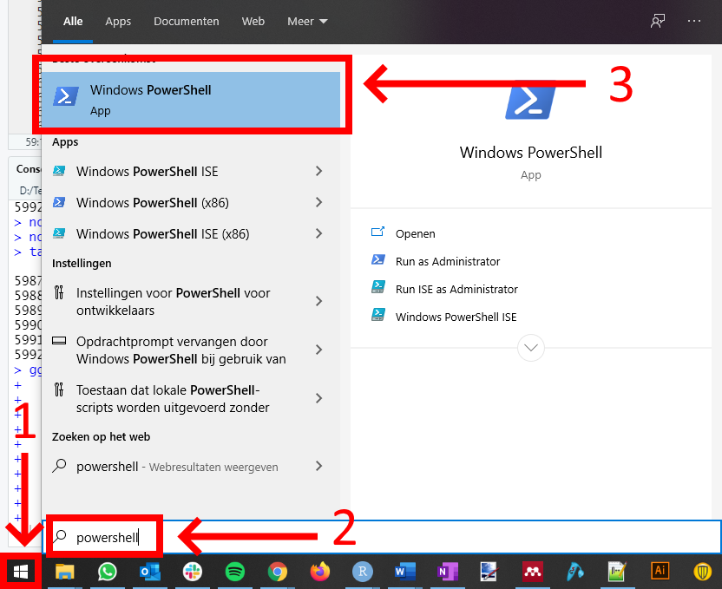
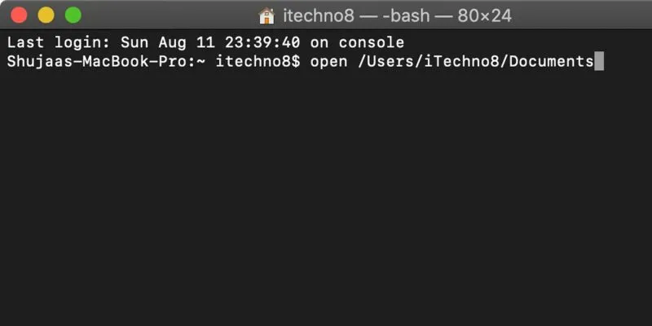
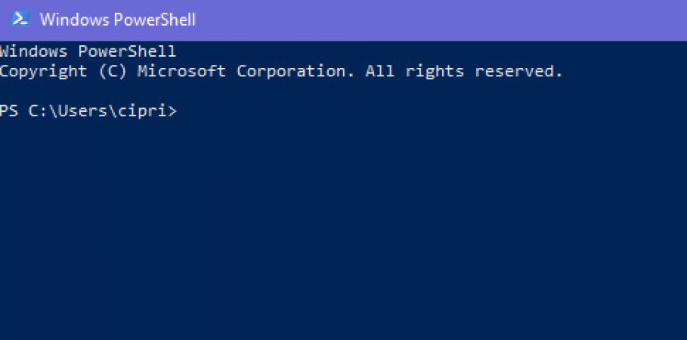
Interact with a computer... like a boss
In order to interact (enter and display data) directly with your computer, without a Graphical Interphase, you need access to a terminal.
In MacOS, open the Terminal app
In Windows, open PowerShell
11

Slide 12
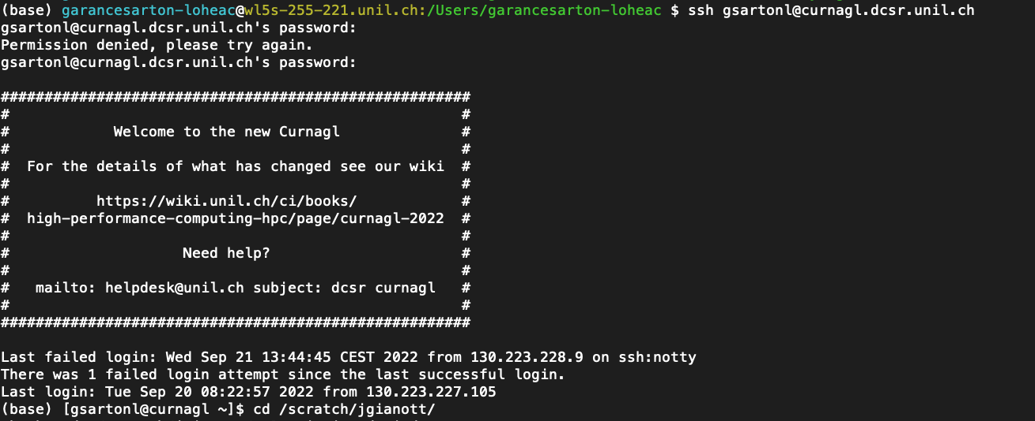
Accessing the Cluster
The command to access the front-end to our cluster is:
ssh <your-username>@curnagl.dcsr.unil.ch
command (ssh)
username (gsartonl)
address
(curnagl.dcsr.unil.ch)
type your password (*****)
12
Notes:
First tinme you’re connecting it will ask you if you want to remember the finger print -> type yes

Slide 13
Accessing the Cluster
The command to access the front-end to our cluster is:
ssh <your-username>@curnagl.dcsr.unil.ch
Wrong password
Welcome message
Info on last session
13

Slide 14

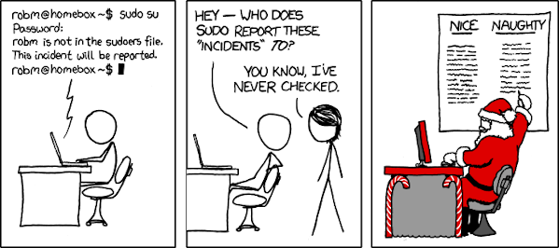
https://xkcd.com/838/
PART 1-2
14

Slide 15

The Terminal and Bash
The BASH is a command line interpreter (shell) and language.
Typically runs in a terminal (text window) where the user types commands (instructions for the computer to execute)
Bash can also read and execute commands from a file (script)
15
Notes:
15
Free replacement for the Bourne shell

Slide 16

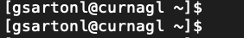
The Prompt…
… is where the computer prompts you to do something
Your terminal
user
computer
location
$ for user
# for admin
type your
command here
The cluster’s terminal
16
Notes:
16

Slide 17
The UNIX file system
17
A method for organizing and storing large quantities of data such that the system is easy to manage
A file system consists of files, relationships to other files, as well as the attributes (metadata) of each file
The UNIX file system is essentially composed of files and directories

Slide 18
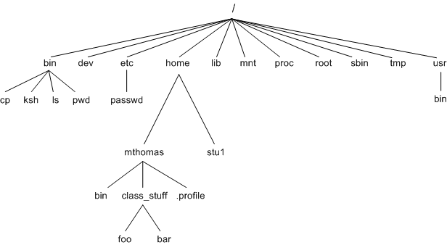
The UNIX file system
root directory
A hierarchical (or tree-like) structure with its highest level directory called root (denoted by / )
Immediately below the root are several subdirectories, most of which contain system files
home directory
Contains files for a given user
Usually located at /users/<username> or /home/<username>
Shorthand: ~
18
Notes:
18
Draw cluster architectucre

Slide 19

What is the difference ?
user
computer
location
$ for user
# for admin
type your
command here
The cluster’s terminal

Slide 20
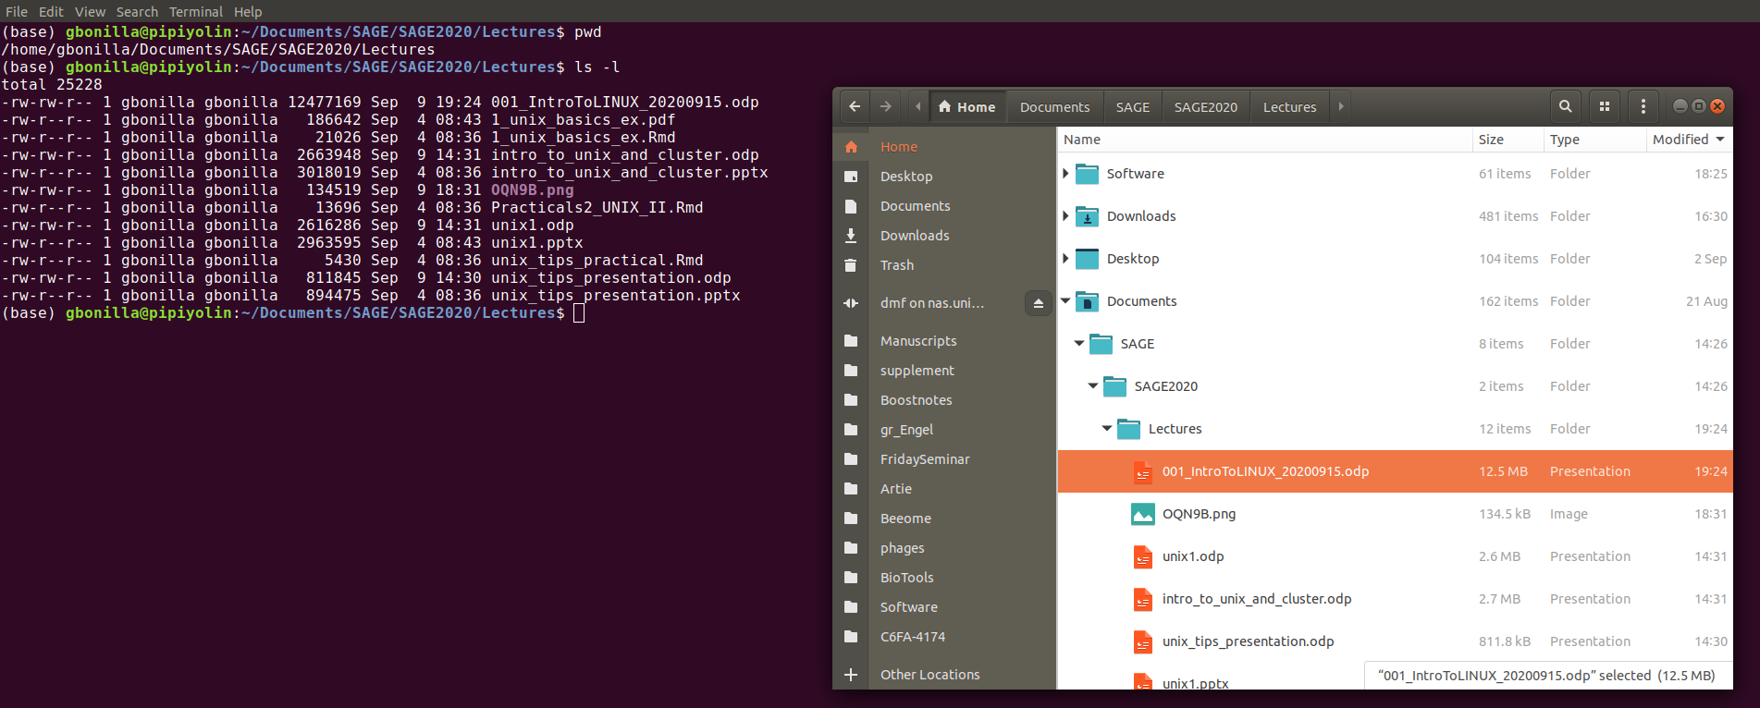
Unix file system
same file
20
Notes:
20

Slide 21
Paths
A path is a unique location to a file or a folder in a file system
The path to a file is a combination of / and alpha-numeric characters
Absolute path
Relative path
The path related to the present working directory (pwd)
It starts at your current directory and uses one of these symbols:
. → represents the current directory
.. → represents the parent directory
Example: ../Desktop
The location of a file or directory from the root directory( / )
Example: /home/gsartonl/Teaching/SAGE22-23/
21

Slide 22
Path Wildcards
. is a reference to the current directory
.. is a reference to the parent directory
~ is a reference to your home directory
22
Notes:
22

Slide 23

SYNTAX to invoke commands
Most commands have the same basic syntax, separated by spaces:
→ first you invoke the command by calling it by name (ls)
→ then you add options with a dash (-l)
→ and finally, you add the filename or directory on which the command will act(/users/<username>)
invoke command list: ls
with option long: -l
on this directory: /users/gsartonl/
23
Notes:
23

Slide 24
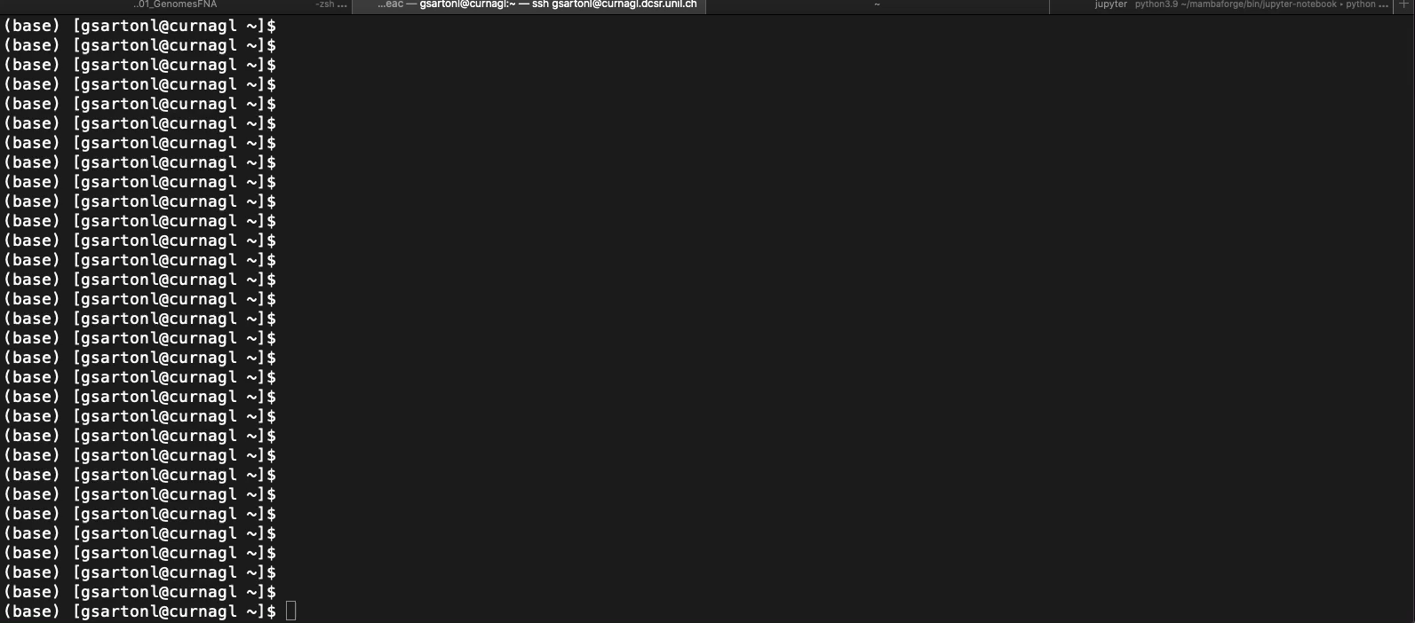

Slide 25
Navigating directories
pwd - print working directory
To know where you are in the file system
ls - list
To see what the files are in the directory
cd - change directory
To move from one directory to another
25
Notes:
25

Slide 26
Moving and copying files
mkdir <path_to_new_dir>
Create a new directory
rm <path_to_filename>
Remove file (there is no undo!!!).
Can also be used for directories (with –r option)
mv <current_path> <new_path>
For moving files OR renaming files
cp <path_to_original_file> <path_to_copy>
Copying files from one path to another
26
Notes:
26

Slide 27
Wildcards and Metacharacters
? means “any single character” (including spaces)
* means “any character sequence” (including spaces or absence of character)
^ means “beginning of the line”
$ means “end of the line”
[ ] squared brackets denote a character that could be...
… any range of letters [a-y] (all lowercase letter except 'z')
… any a range of numbers [0-9] (any digit)
… any of a set of characters [aAeEiIoOuU] (any vowel, capitalized or not)
… any of a set of numbers [13579] (any odd number)
27
Notes:
27

Slide 28
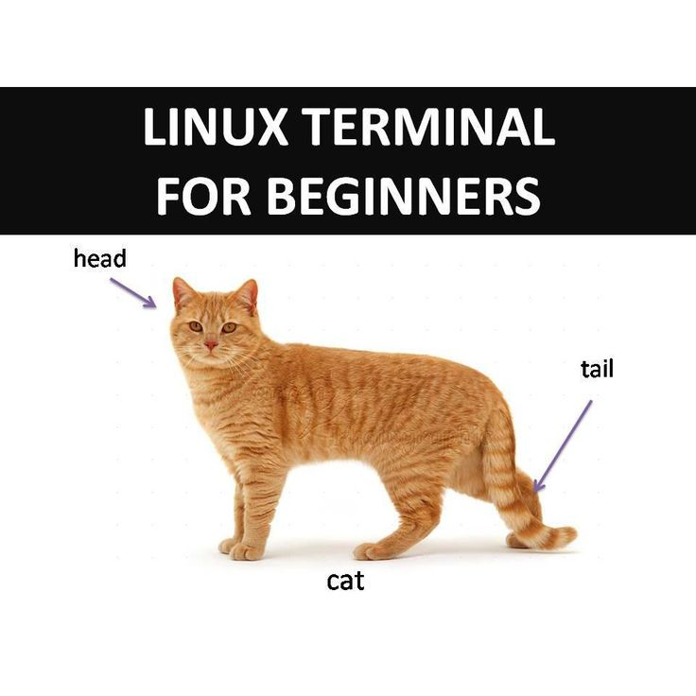
Commands for reading files
28
more <filename>
Prints out as much of file that will fit in screen, then you have to scroll
less <filename>
Same as more, but can page forwards and backwards through file
To quit, type “q”
cat <filename> - concatenate
Prints the whole content of specified files on screen
head <filename>
Prints the first 10 lines of a file
tail <filename>
Prints the last 10 lines of a file
Notes:
28

Slide 29
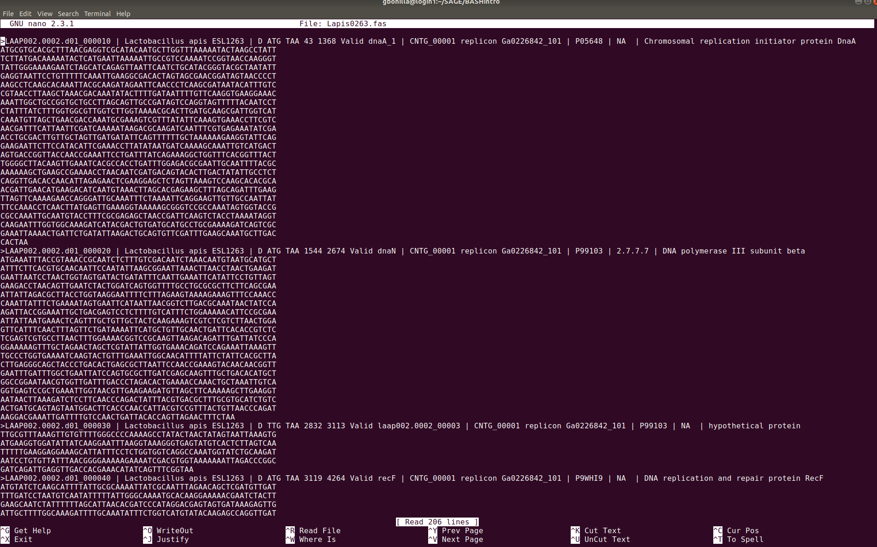
Reading and writing files with text editors
nano <name_of_file>
(to open the file)
<ctrl+X> (to save and exit)
nano will communicate with you here!
command menu
29
Notes:
29

Slide 30
BONUS command: “link”
In the cluster, you have two directories:
your Home Directory:
/users/<username>/
your Working Directory:
/scratch/jgianott/sage/SAGE2022_23/<username>
Let's make a shortcut to your working directory using the command “link”
30
Notes:
30

Slide 31

Beware !
The computer
you
Notes:
The computer is stupide. It will do exactly what you ask

Slide 32
Do it Yourself!
PART 3-6
32
Notes:
32

Slide 33
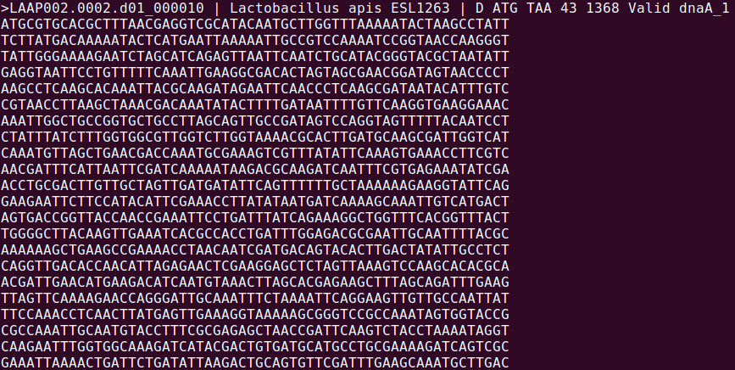
FASTA format
FastA format is a simple raw-text format we use to represent sequences using one-letter codes for amino-acids or bases. It contains two elements: a line descriptor or “header” followed by the sequence.
header
sequence
33
Notes:
33

Slide 34
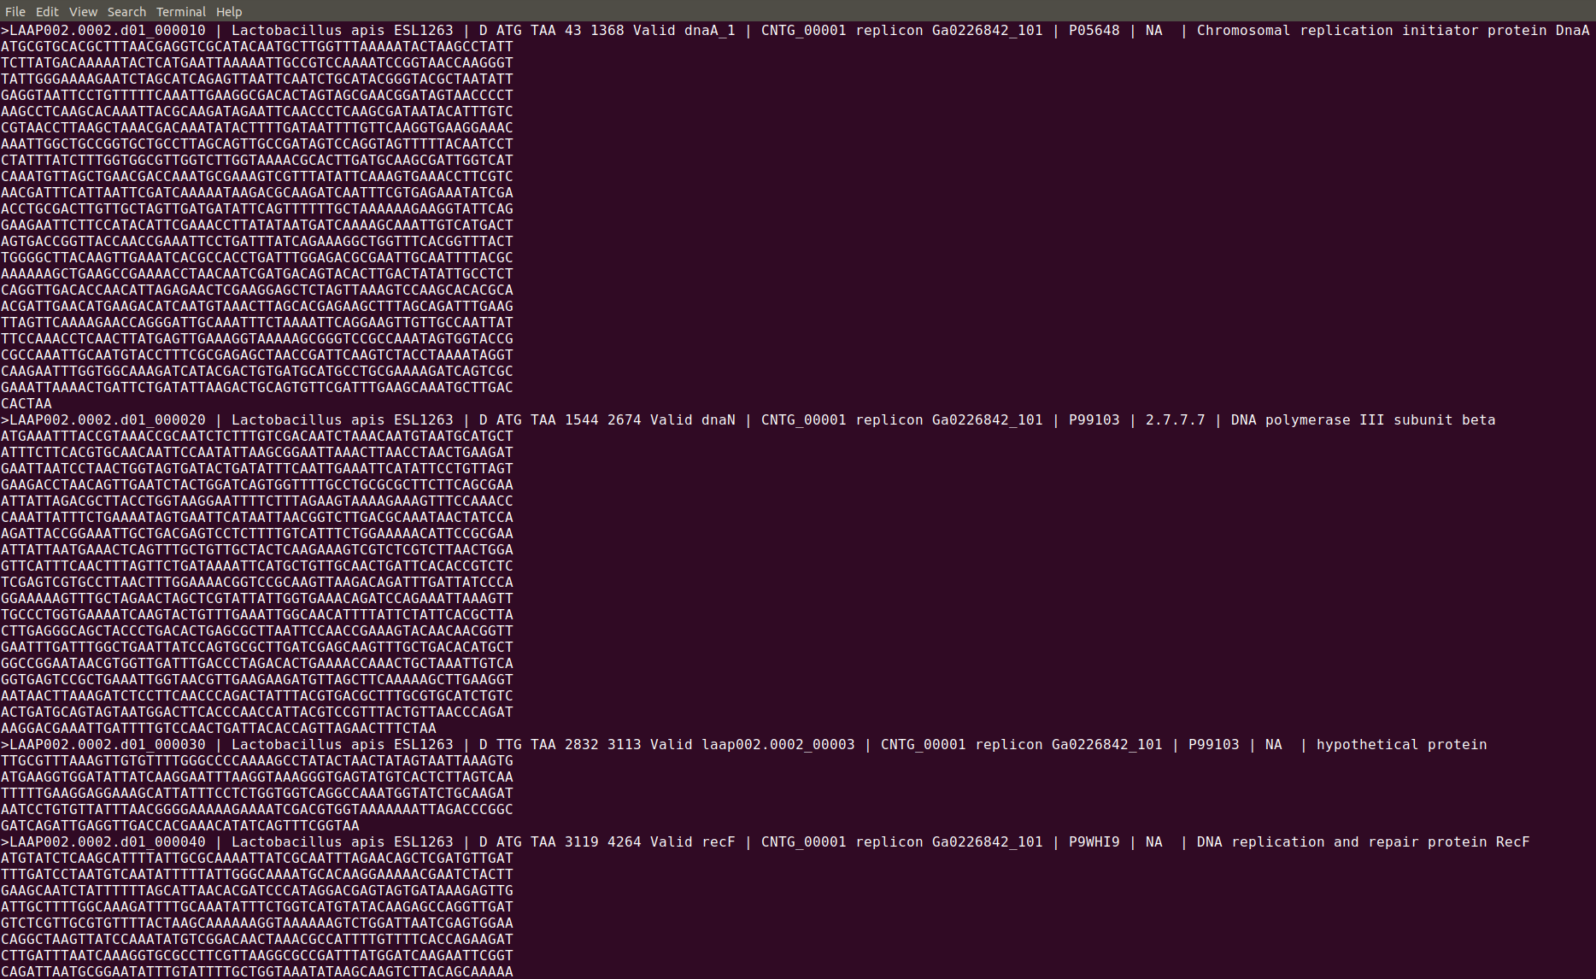
FASTA format
header 1
sequence 1
This allows to quickly generate files that contain multiple genes or chromosomes or other types of sequences, all with one line of descriptors and the sequence...
header 2
sequence 2
header 3
sequence 3
header 4
sequence 4
34
Notes:
34

Slide 35
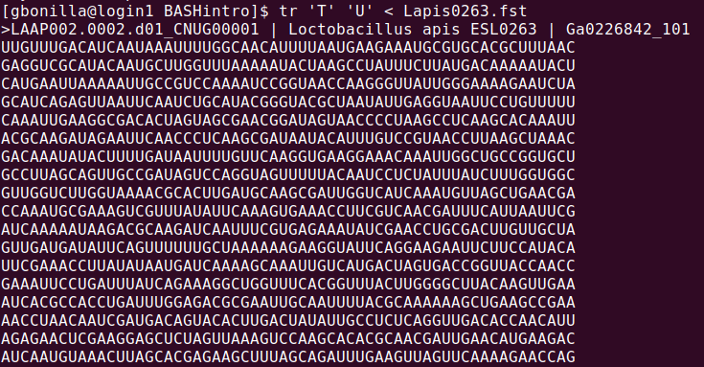
Basic substitution: tr
tr '<old>' '<new>' < <filename>
Translate allows you to substitute or delete single characters
Let's translate DNA into RNA by changing all T's into U's
35
Notes:
35

Slide 36

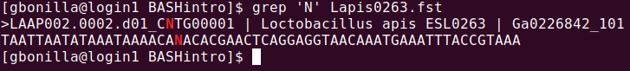
Pattern recognition: grep
The full power of Linux is in pattern recognition and
substitution
grep '<pattern>' <file>
Search for a pattern in a file and return the lines where it occurs.
Let's search how many unresolved nucleotides are in the sequence:
36
Notes:
36

Slide 37
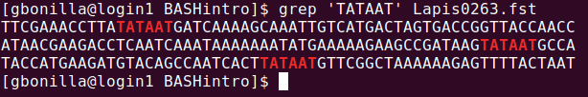
Pattern recognition: grep
grep '<pattern>' <file>
Search for a pattern in a file and return the lines where it occurs.
Let's search for the TATA-box in the contig file:
grep 'TATAAT' Lapis0263.fst
37
Notes:
37

Slide 38
Pattern recognition
grep <option> '<pattern>' <file>
-A After. Print the line of occurrence plus x lines after it.
grep -A1 'TATAA' Lapis0263.fst
-B Before. Print the line of occurrence plus x lines before it.
grep -B3 'TATAA' Lapis0263.fst
-c Count the number of lines where pattern occur.
grep -c 'TATAA' Lapis0263.fst
-i Ignore uppercase or lowercase.
grep -i 'tataa' Lapis0263.fst
-v Invert. Print the lines where the patter does NOT occur.
grep -v 'TATAA' Lapis0263.fst
38
Notes:
38

Slide 39

Pattern substitution: sed
sed is a powerful program to identify a pattern and substitute it
sed 's/<old>/<new>/g' <file>
The syntax requires you:
→ enclose the substitution command in single-ticks '''
→ indicate you want to substitute 's/'
→ then you write the pattern to search between the first backslashes '/old/'
→ then the substitute patter between the second backslashes '/new/'
→ and that you want to substitute all patterns in the file '/g' (global)...
39
Notes:
39

Slide 40
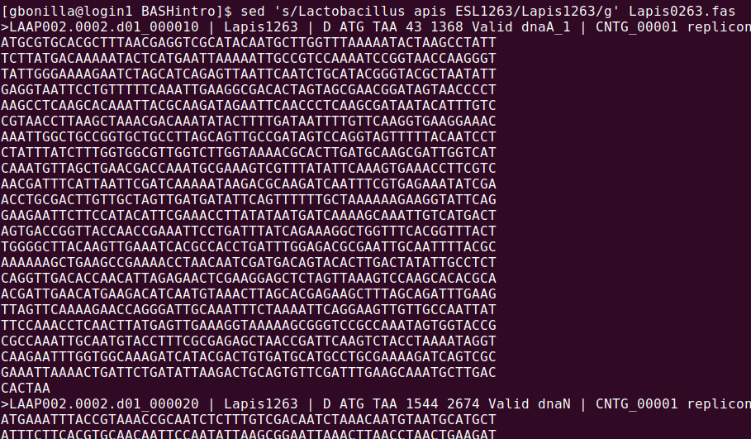
Pattern substitution
Example:
Shorten the species name
Lactobacillus apis ESL1263
to
Lapis1263
sed 's/<old>/<new>/g' <file>
*NOTE: sed will always print on screen, it does NOT modify the original file.
40
Notes:
40

Slide 41
Pipes and Redirections
commandX > Y (redirect overwrite)
write the output of command X in file Y
commandX >> Y (redirect append)
append the output of command X in file Y
commandX | commandY (pipe)
take the output of command X as an input to command Y
41
Notes:
41

Slide 42
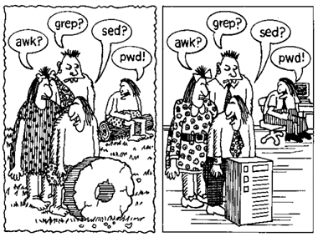
Do it Yourself!
http://www.netzmafia.de/skripten/unix/unix5.html
PART 7
42
Notes:
42

Slide 43
Automatization
Using cp and mv with single filenames is easy... unless you have 100 files!
For this, we can use wildcards:
List all files that end with .fst:
ls *.fst
Copy all files named MyDataset regardless of their extension:
cp ../MyDataset.* ./
Move all files version 105 to 108 to the current directory:
mv ../FinalChapter_version_10[5-8].docx ./
43
Notes:
43

Slide 44
Automatization using Wildcards (reminder)
? means “any single character” (including spaces)
* means “any character sequence” (including spaces or absence of character)
^ means “beginning of the line”
$ means “end of the line”
[ ] squared brackets denote a character that could be...
… any range of letters [a-y] (all lowercase letter except 'z')
… any a range of numbers [0-9] (any digit)
… any of a set of characters [aAeEiIoOuU] (any vowel, capitalized or not)
… any of a set of numbers [13579] (any odd number)
44
Notes:
44

Slide 45
Automatization using Pipes and Redirections
commandX > Y (redirect overwrite)
write the output of command X in file Y
commandX >> Y (redirect append)
append the output of command X in file Y
commandX | commandY (pipe)
take the output of command X as an input to command Y
45
Notes:
45

Slide 46
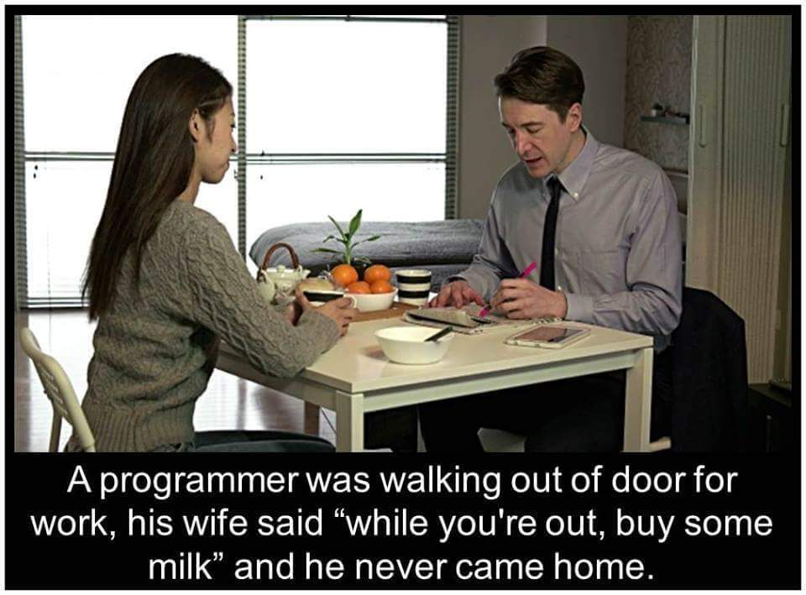
Loops
Coolest thing you'll learn today is to perform the same list of commands on several files with a structure called a loop!
The for loop reads: For all files in a list, do the following until you're done:
for <variable> in <list>; do
<action 1>;
<action 2>;
...
<action N>;
done
46
Notes:
46

Slide 47
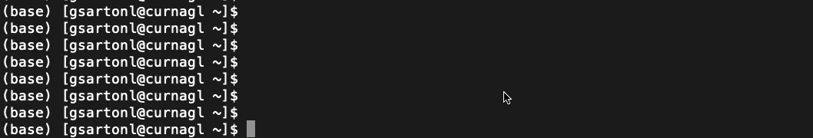
Loops and variables
Variables in BASH have the prefix '$' before the name
A variable will take the specific values of a list.
$ for var in Jane Miguel Mary; do
> echo $var
> done
Jane
Miguel
Mary
define variable name
give a list
just print the value of variable $var
47
Notes:
47

Slide 48
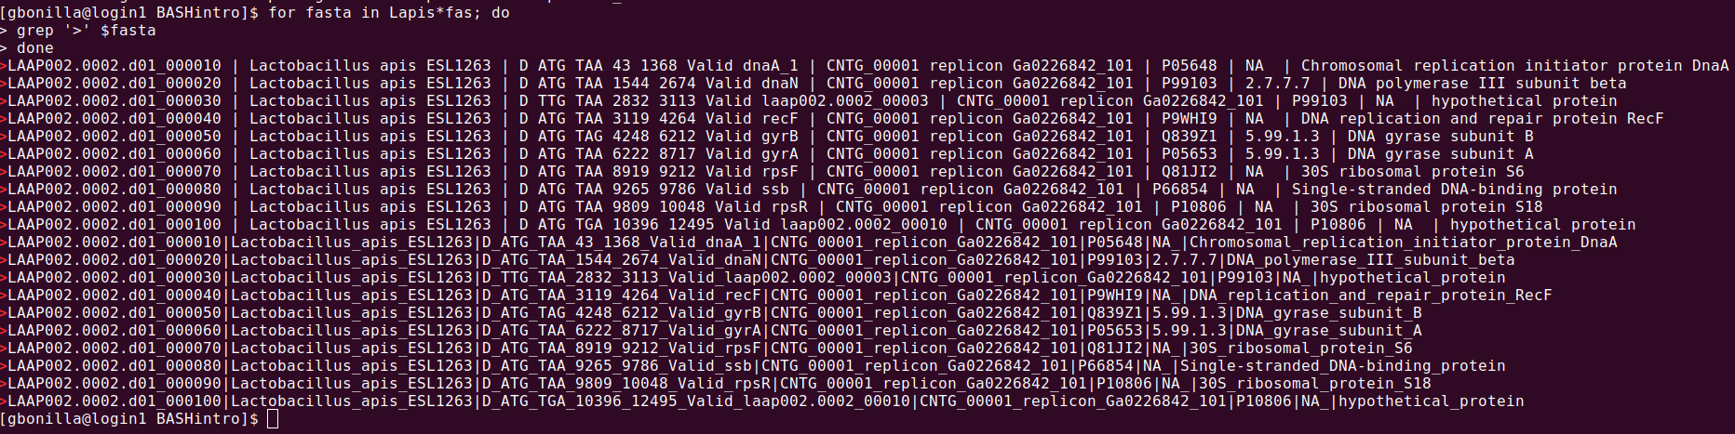
Loops and variables
Print all headers in each FASTA file in the current directory:
$ for fasta in *fas; do
> grep '>' $fasta
> done
48
Notes:
48

Slide 49

Loops and variables
You can modify variable names conveniently by using character extrapolation, using curly brackets and the symbol % to define the part you are taking away...
for example, to change the extensions of files .fas to .FASTA:
$ for files in Lapis*fas; do
> mv $files ${files%fas}FASTA
> done
49
Notes:
49

Slide 50
Variables
Environmental variables
Variables that are set up in your shell when you log in
Most of them affect the way your Unix shell works for you
Examples
$USER
$LANG
$PATH
$PATH is the concatenated paths for all directories which unix will search through to find executables
Tip: Do NOT use variable names in uppercase!
50

Slide 51
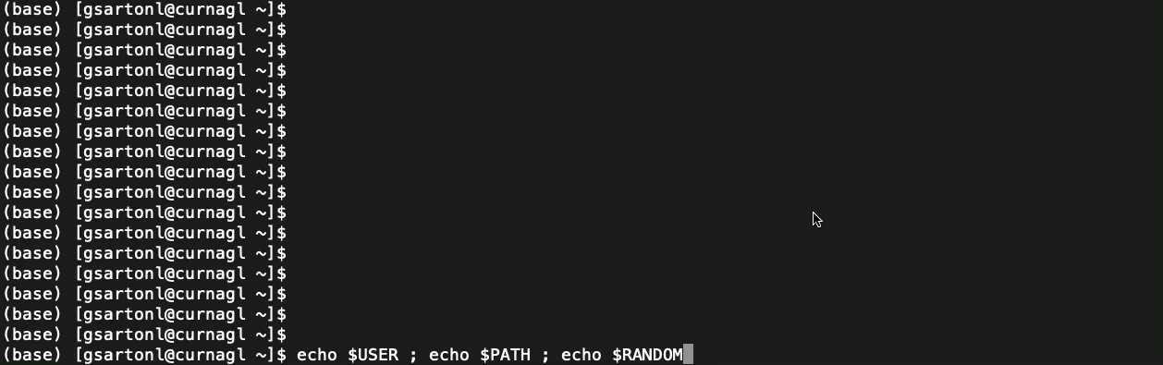

Slide 52
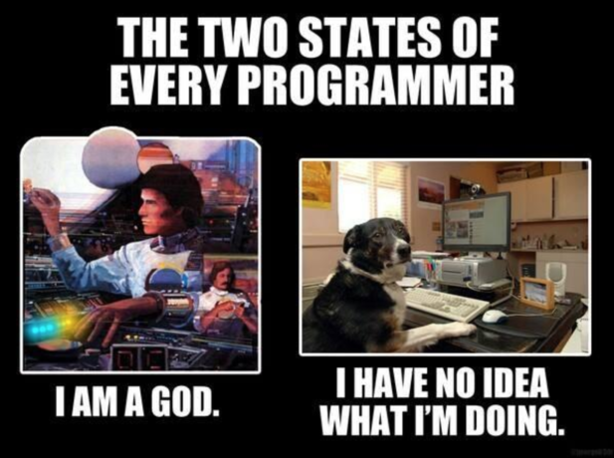
Scripting
Scripts are lists of commands that are
sequentially interpreted and executed by a
specific programming language and
run-time environment.
Scripts are useful to automatize the execution of complex tasks.
We will be using scripts written to the Unix-like Shell BASH,
the same interpreter that you've been using from the command-line.
52
Notes:
52
To remember what you’ve been doing

Slide 53
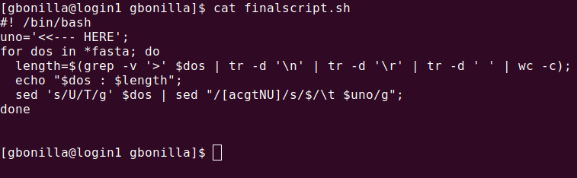
Scripting
What is this script doing?
53
Notes:
53

Slide 54
Do it Yourself!
PART 8-9
54
Notes:
54

Slide 55
Learning Objectives
By the end of this lecture…
1. … you should understand...
… the advantages of using a Linux-based system on a computing cluster
… the file structure of a UNIX system
2. … you should be able to...
… connect from your computer to the cluster,
… manipulate files inside and into the file system,
… perform basic operations on sequence files,
… write and run simple scripts from bash.
55
Notes:
55

Slide 56
Other Resources:
BASHtutorial.html is an HTML tutorial (you open it with a web browser) that you can follow on your own that revises all we've seen today and more! Prepared by Yassine El Chazli and German Bonilla-Rosso.
The online tutorial DataCarpentry introduction to command line:
https://datacarpentry.org/shell-genomics/
A cheatsheet prepared by EMBnet
https://embnet.vital-it.ch/documentation/UNIX03.pdf
Google!
56
Notes:
56

Slide 57
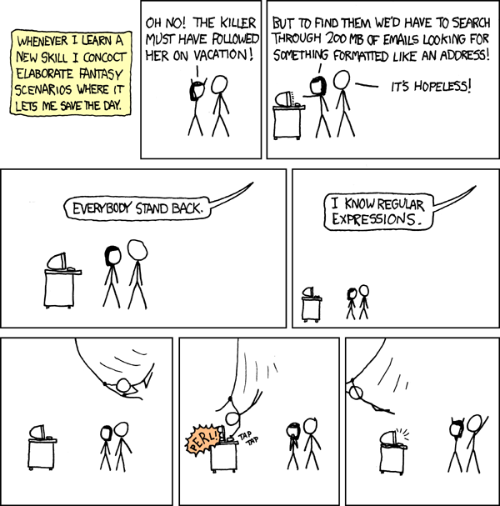
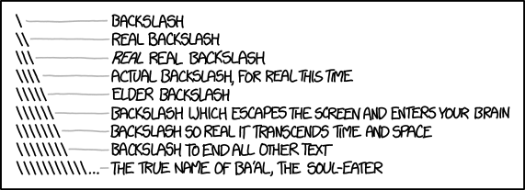
https://xkcd.com/1638/
https://xkcd.com/208/
57
Notes:
57

